Slide 1
Twist Polynomials of Delta-Matroids 3
By Lozinskiy Leon, Yuschak Daniel

Slide 2
Quick Recap
Previously we’ve talked about how Daniel was able to prove that all delta-matroids with twist polynomial a monomial are binary by generalizing the methods of Yan and Jin. Ultimately, the point was to exclude the 5 forbidden minors for binary delta-matroids.

Slide 3
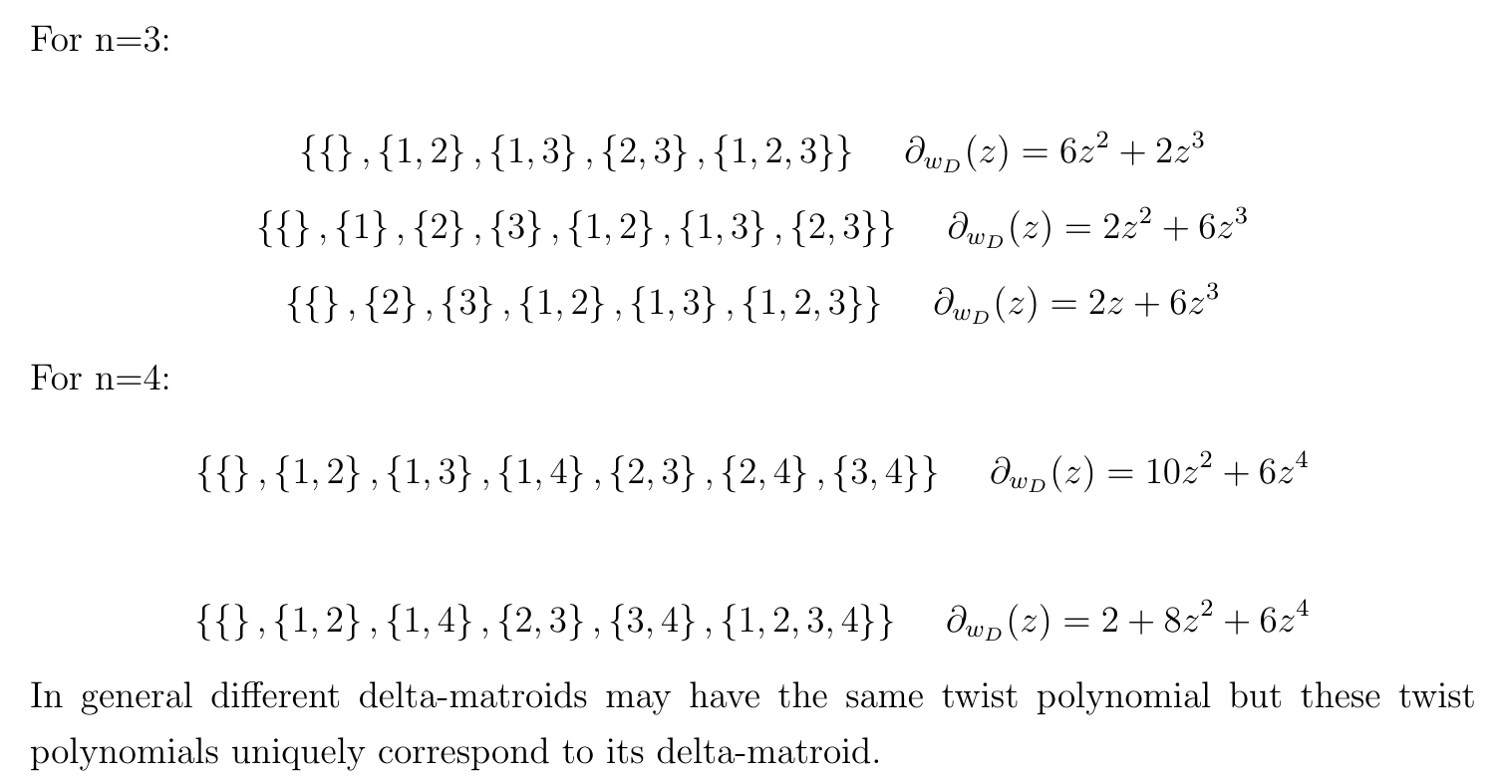
The Forbidden Minors

Slide 4
A different approach
Thinking in terms of forbidden polynomials:
Find a good property of the twist polynomial that is invariant under deletion(note that twisting already doesn’t effect the twist polynomial)
Show that no combination of deletions(or twists) can bring a monomial to one of the 5 forbidden twist polynomials
Since each of the forbidden polynomials corresponds uniquely to a forbidden minor, we have also shown that these forbidden minors cannot be reached
This means we’ve shown that all delta-matroids with twist monomial are binary

Slide 5
Why should this work(morally)?
We already know that all delta-matroids with twist monomial are binary, and we know that the forbidden polynomials and forbidden minors are in 1-to-1 correspondence
This means that in this case all of the necessary information is already fully contained in the twist polynomials

Slide 6
Why such an approach is useful
We are having trouble finding forbidden minors for binomials and beyond, generalizing the work of Yan and Jin gets more difficult here.
But, this other approach could still work in the same way and be used to produce forbidden polynomials. Then, any minor with twist polynomial a forbidden polynomial is a forbidden minor.
So, the method should generalize to twist polynomials with more than one term

Slide 7
Deleting by a loop or coloop

Slide 8
Conjecture of partial converse

Slide 9
The distance function of a delta-matroid
Instead of considering w(D*A) = max|F Δ A| - min|F Δ A|, consider f_{D}(A) := min|F Δ A|
This doesn’t lose information about the twist polynomial, because w(D*A) = max|F Δ A| - min|F Δ A| = (n - min|F Δ A^{c}|) - min|F Δ A| = n - (f_{D}(A) + f_{D}(A^{c}))
Considering the twist polynomial of D is essentially equivalent to considering f_{D}(A) + f_{D}(A^{c}) across all possible A ⊆ E.

Slide 10
Set functions and smoothness
f_{D}(A) := min|F Δ A|
Define a “set function” to be any f: ℙ(E) → ℕ₀
Call a set function “1-smooth” when for any X ⊆ E and any u ∈ E, |f(X) - f(X Δ {u})| ≤ 1

Slide 11
Set system functions and delta-matroid functions
A “set system function” is a set function of the form f_{D}(X) = min|F Δ X| for some set system D
Equivalently, a set function is a set system function when it is 1-smooth and
for any X ⊆ E with f(X) ≠ 0, there exists u ∈ E such that f(X Δ {u}) < f(X)
A “delta-matroid function” is a set function of the form f_{D}(X) = min|F Δ X| for some delta-matroid D
Equivalently, a set function is a delta-matroid function when it is a set system function and
for any X, Y ⊆ E with f(X) ≠ 0 and f(Y) = 0, there exists u ∈ X Δ Y such that
f(X Δ {u}) < f(X)

Slide 12
Minors of set functions
Define twists of a set function by [f * A](X) = f(X Δ A)
Define deletion and contraction for set functions by [f \ e](X) = f(X) and [f / e](X) = f(X ∪ {e}), where X ⊆ E \ {e}
A “minor” of a set function f is any set function obtained from f by a sequence of twists, deletions, and contractions
For any set system D, f_{D * A} = f_{D} * A
However, in general for set systems f_{D \ e} ≠ f_{D} \ e and f_{D / e} ≠ f_{D} / e
In fact, f_{D} \ e and f_{D} / e may not even be set system functions at all

Slide 13
Minors of set system functions
Any minor of a 1-smooth set function is a 1-smooth set function, and any set system function is 1-smooth, so any minor of a set system function is 1-smooth
Actually, a set function is a minor of a set system function if and only if it is 1-smooth
Call a set system “grounded” if there exists X ⊆ E such that f(X) = 0
For which set system functions f is any grounded minor of f also a set system function?
This is equivalent to f being a delta-matroid function

Slide 14
Equivalent definitions of delta-matroid functions
For a set function f, the following are equivalent:
i) f(X) = min|F Δ X| as F varies across the feasible sets of some delta-matroid
ii) f is grounded, 1-smooth, and for any X, Y ⊆ E with f(X) ≠ 0 and f(Y) = 0, there exists u ∈ X Δ Y such that f(X Δ {u}) < f(X)
iii) f is grounded and any grounded minor of f is a set system function

Slide 15
Twist functions of set functions
For any set function f, define the twist function 𝜏_{f}(X) = f(X) + f(X^{c})
If 𝜏_{f} is constant, what can be said about the twist functions of the grounded minors of f?
If we only assume that f is 1-smooth and grounded, nothing - any 1-smooth grounded set function is a minor of a 1-smooth grounded set function with a constant twist function
What if f is also a delta-matroid function?

Slide 16
Twist binomials of even binary delta-matroids
Suppose D is an even binary delta-matroid with a twist binomial
The possible forms of the twist binomial are:
a + bz²
az² + bz⁴
az⁴ + bz⁶
...
Suppose the twist binomial is of the form a + bz²

Slide 17
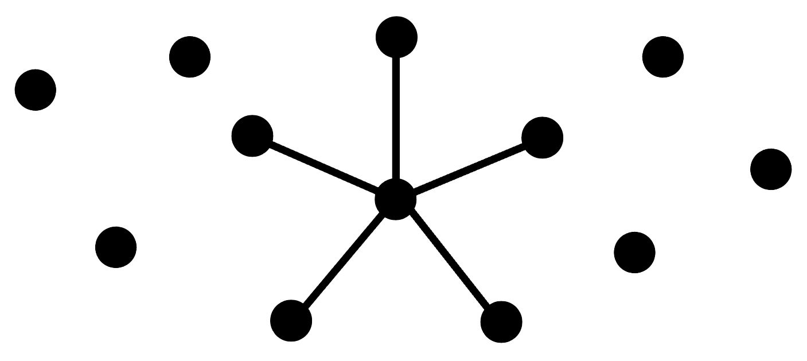
The twist binomial a + bz²
An even binary delta-matroid D has a twist polynomial of the form a + bz² if and only if the graph of D consists of a single star on 2 or more vertices, and possibly also several isolated vertices

Slide 18
Proof of sufficiency
Suppose D is an even binary delta-matroid whose graph is a star on n vertices
The feasible sets of D are ∅, {1, 2}, {1, 3}, ..., {1, n}
Let D’ = D * {1}
The feasible sets of D’ are {1}, {2}, {3}, ..., {n}
w(D’ * ∅) = w(D’ * E) = 0
If e ∈ A and f ∉ A, then A \ {e} ∈ D’ * A and A ∪ {f} ∈ D’ * A, so w(D * A) = 2
So the twist polynomial of D is 2 + (2^{n} - 2)z²

Slide 19
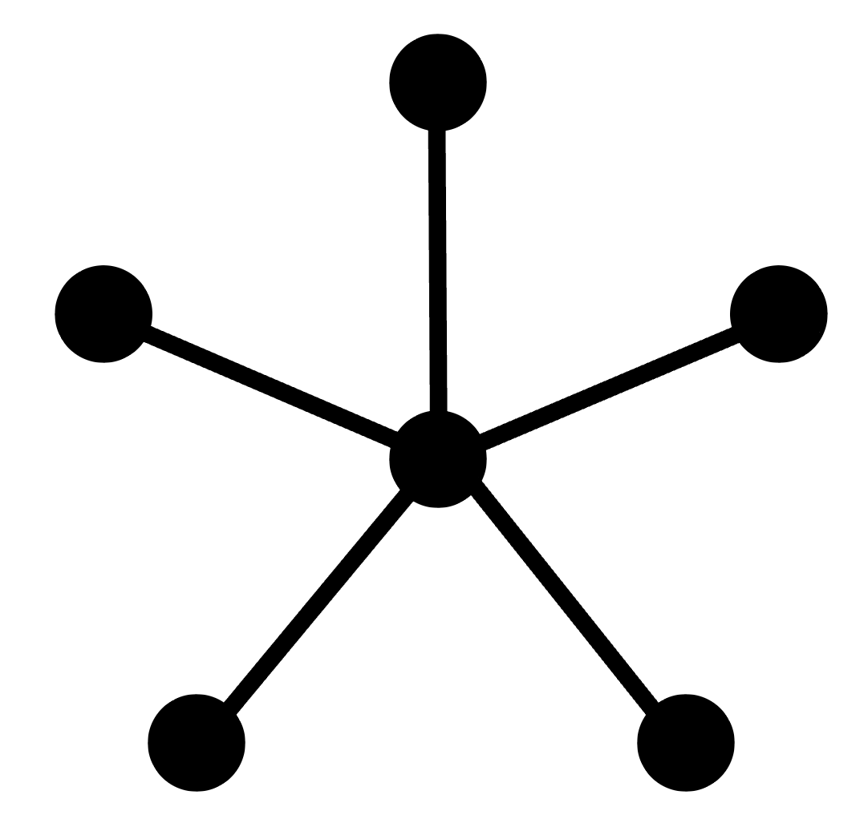
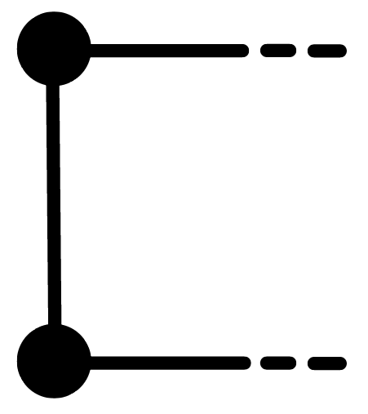
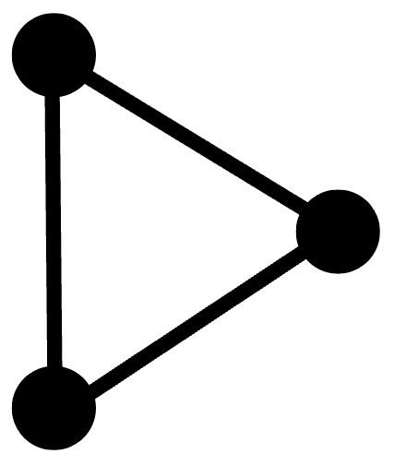
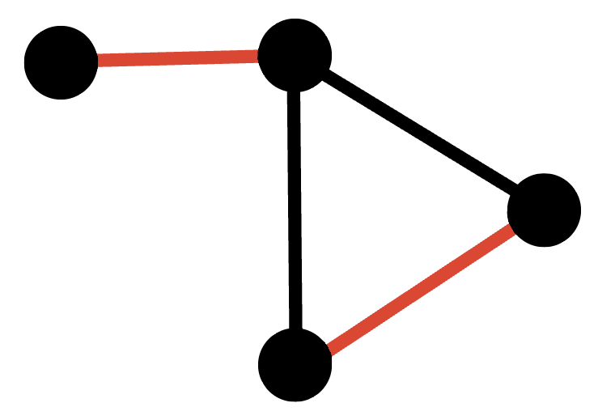
Proof of necessity
Suppose D is an even binary delta-matroid whose twist polynomial is of the form a + bz²
Any two edges of D must share a vertex, since otherwise there exists {e, f}, {g, h} ∈ D, and then ∅, {e, f, g, h} ∈ D * {e, f}, so the twist polynomial would be of degree at least 4
If all edges simultaneously share the same vertex, then this is a star
Otherwise, there is an edge sharing different vertices with 2 other edges
Since those 2 edges also share a vertex, these 3 edges form a triangle
Aside from this triangle, there can be no additional edges in the graph
Since the triangle has a twist monomial, the only possible graph is a star

Slide 20
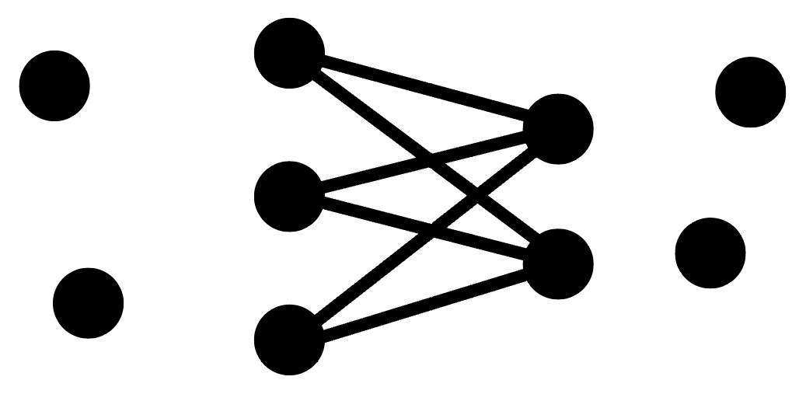
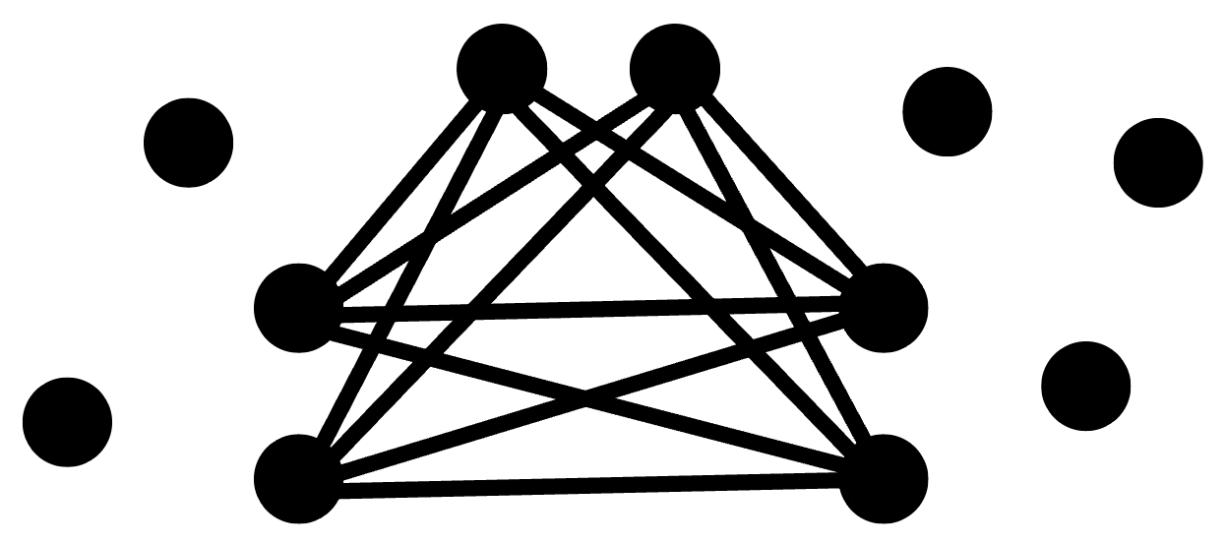
Width-2 even binary delta-matroids
An even binary delta-matroid is of width 2 if and only if its graph consists of either a single complete bipartite graph or a single complete tripartite graph, and possibly also several isolated vertices
or
A width-2 even binary delta-matroid has a twist polynomial of the form az² + bz⁴ if and only if its graph consists of some complete tripartite graph other than the triangle, and possibly also several isolated vertices

